Slide 1
devcontainers
Notes:
Jess – hi and if you wrong please leave
Start with codespaces
- do a little demo, play a little game
- can use on locked down devices – just need a browser
- wanted to make the precon accessible, easy to follow along, reduce the amount of support\questions for people trying to get setup

Slide 2

Why?
Photo by Eric Welch on Unsplash

Slide 3

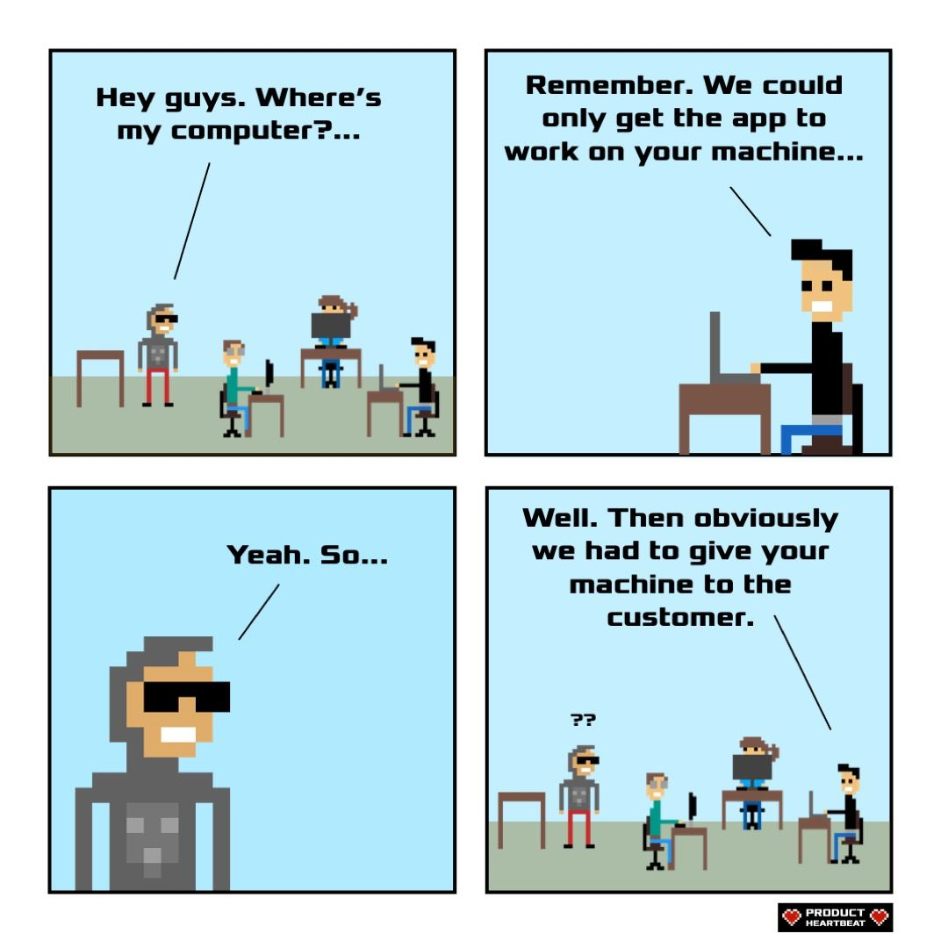
Product Heartbeat - Comics - Works on my machine
Photo by Rebecca Prest on Unsplash

Slide 4

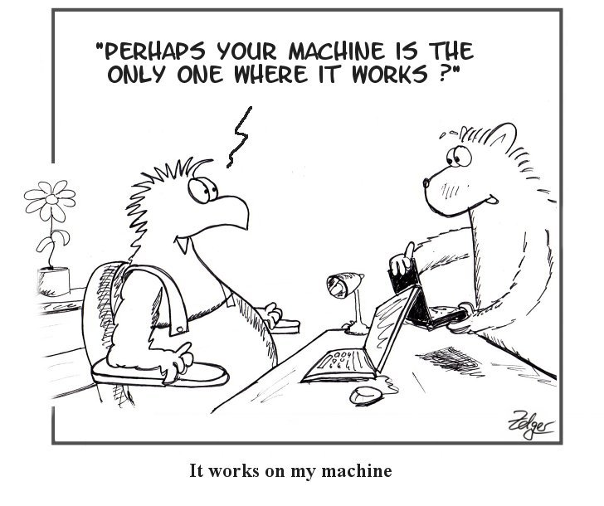
Simply the Test: IWOMM - It Works on My Machine (simply-the-test.blogspot.com)
Photo by Marta Smith on Unsplash

Slide 5

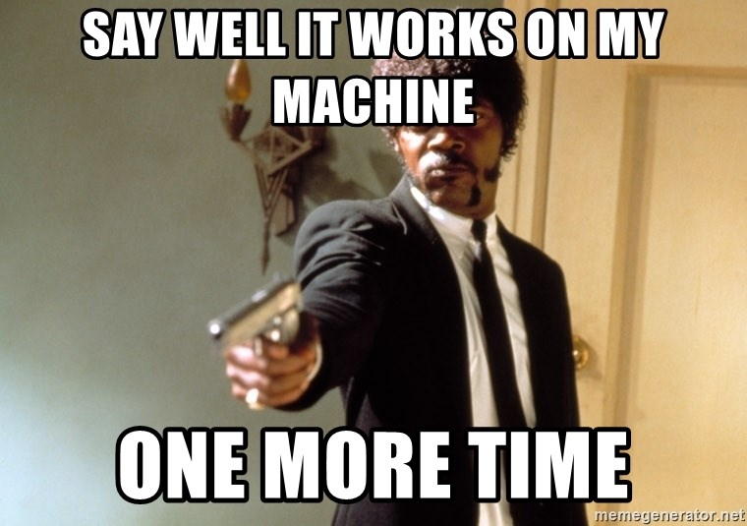
Photo by Frank Busch on Unsplash

Slide 6
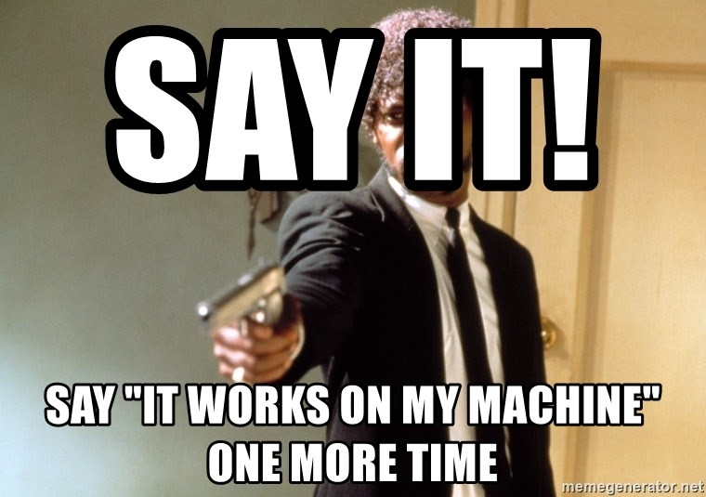
Photo by Frank Busch on Unsplash

Slide 7
Photo by Frank Busch on Unsplash

Slide 8
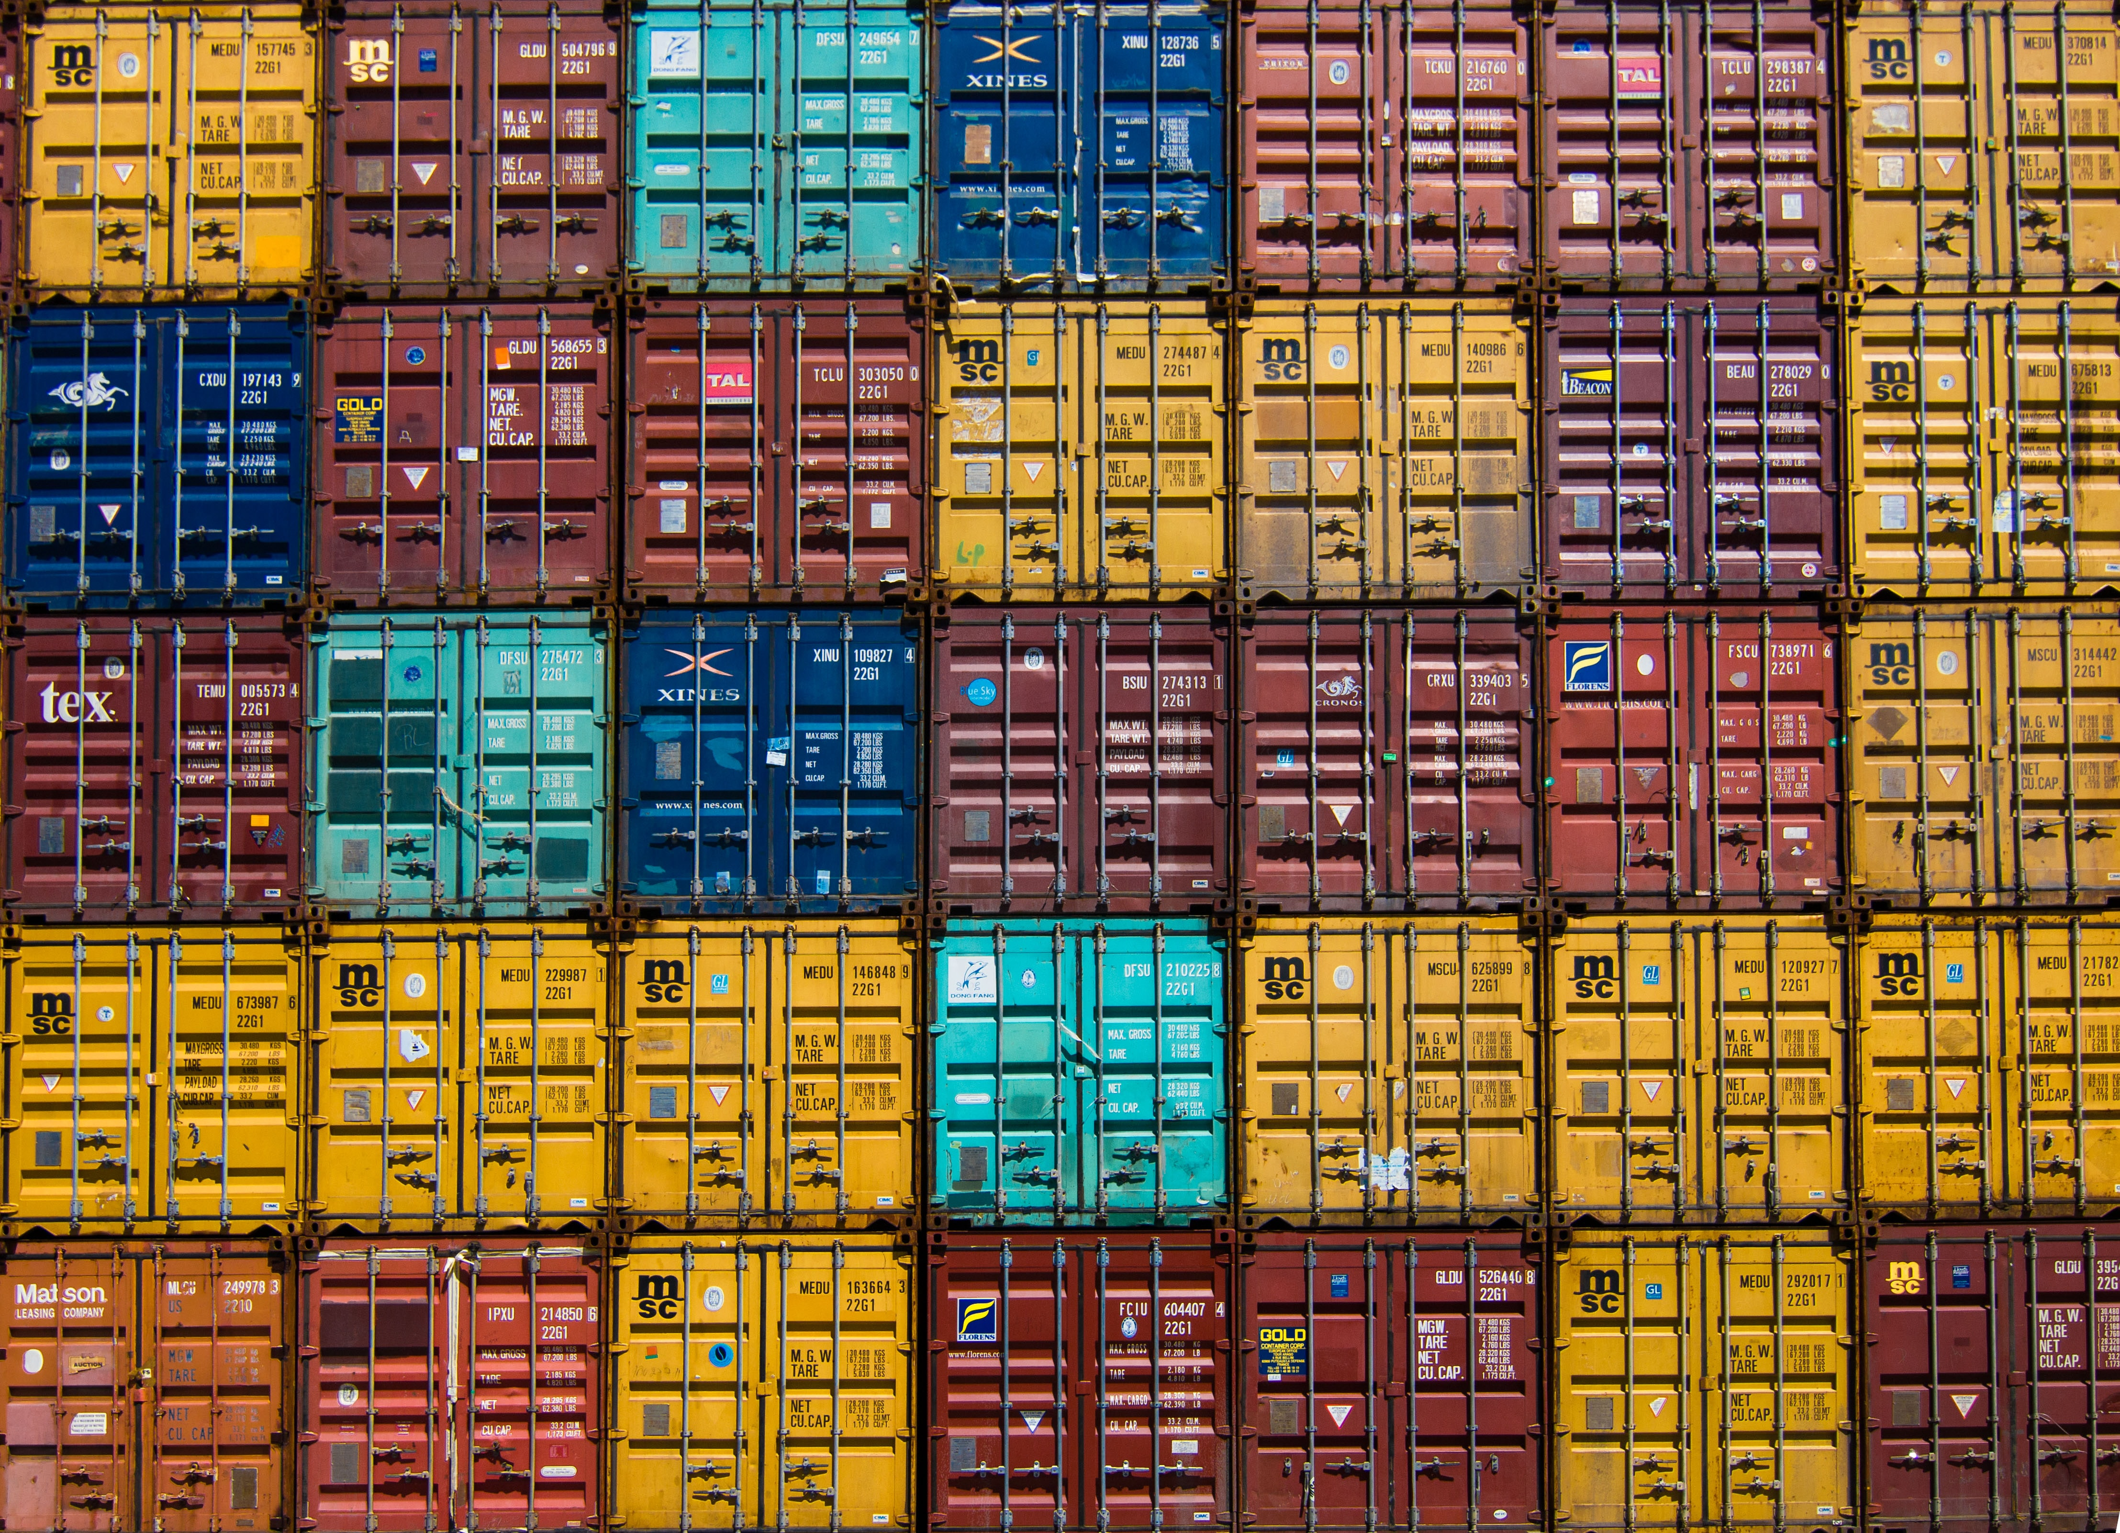
Identical
So that everyone is able to have the same experience and able to concentrate on developing rather than setting up.
Photo by Jan Antonin Kolar on Unsplash
Notes:
Rob
Want the same environment for everyone and both of us without issues under our control
- Having the same extensions for example – Jess had Git graph and Rob didnt

Slide 9
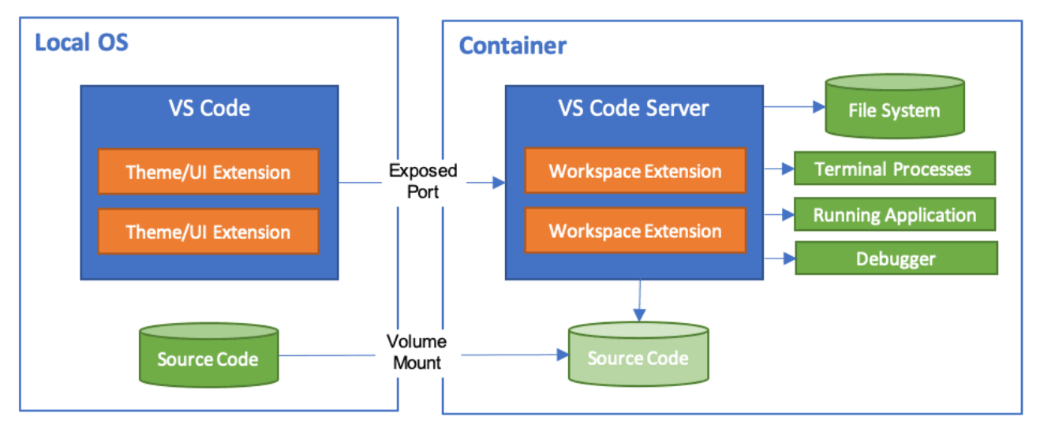

Dev Container
code.visualstudio.com/docs/remote/containers
Notes:
Jess
Run VSCode locally and connect to
a docker container as a remote server
Setup the environment as code – then it can be used by anyone
Include vs extensions
Mount source code folder into container
Can install things inside the container that you need – and not have to install on your desktop
We have options for how we setup dev container
Could use ‘post create command’ in devcontainer.json
Or could bake it into the container image and build the devcontainer from that image

Slide 10
Dev Container
code.visualstudio.com/docs/remote/containers
Notes:
Jess
Run VSCode locally and connect to
a docker container as a remote server
Setup the environment as code – then it can be used by anyone
Include vs extensions
Configuration as code
Mount source code folder into container
Can install things inside the container that you need – and not have to install on your desktop
We have options for how we setup dev container
Could use ‘post create command’ in devcontainer.json
Or could bake it into the container image and build the devcontainer from that image

Slide 11
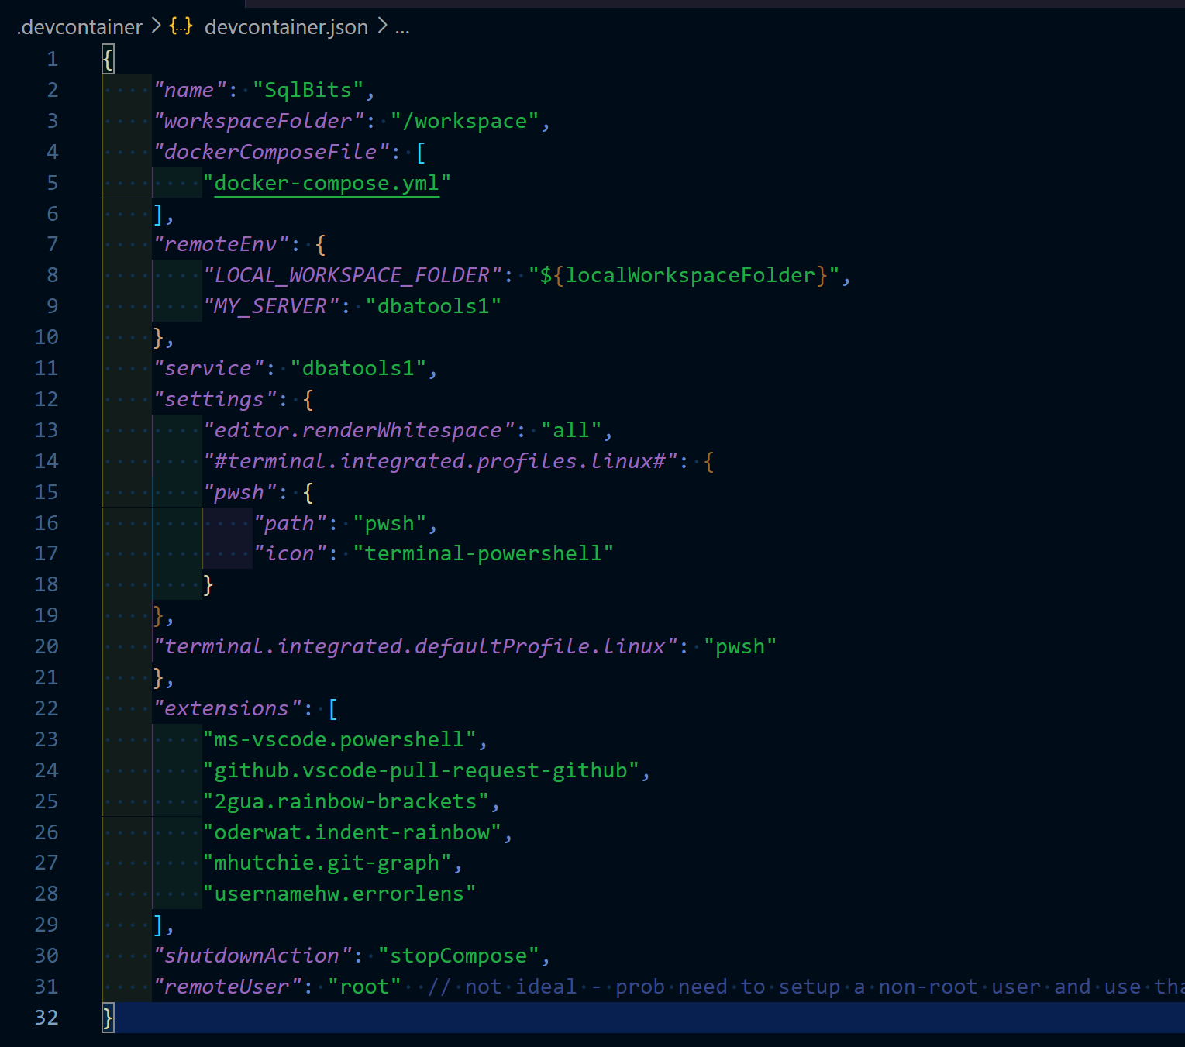
devcontainer.json
Notes:
Jess
Just add a devcontainer.json and set it up how you want your environment to be
Anybody that opens the repo in VsCode – it’ll see this devcontainer.json file and prompt you to open in container – we’ll point that out in the demo
Workspace folder – where it’ll end up
Service – is where we want to go - ‘the service you want to work on’
Extensions –

Slide 12
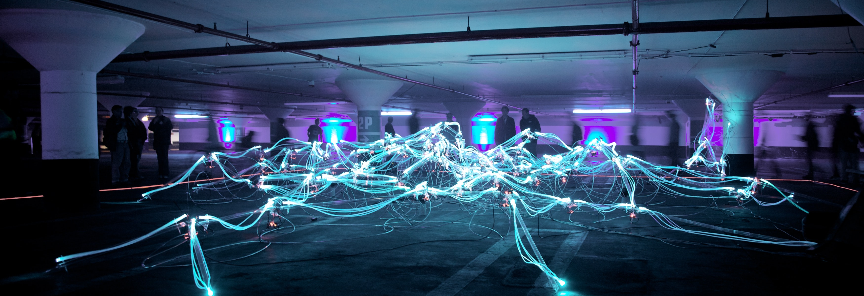
Photo by Marius Masalar on Unsplash
Notes:
Rob - We are not animals

Slide 13


